Slide 1
Trust Administration Mobile
App
Second Iteration Planning
Cheetah Kai

Slide 2

Partner Recap
Company
Accutech, Iris Beasley
Cheetah → Web software for trust administrators and officers
Our “Job”
Mobilize Cheetah
Our Main Focus
Cheetah’s most important features

Slide 3

First Iteration Features
Login system
Homepage UI
New activity UI
New Task UI

Slide 4

Second Iteration Features
Ability to save and assign a task
Ability to create a new activity
Push notifications
Basic overview of an account
Alter login system
Time limit

Slide 5

Member’s Task
Ja’von: UI
Drew: Task saving and assigning
Nick: Database Management
Chris: API

Slide 6
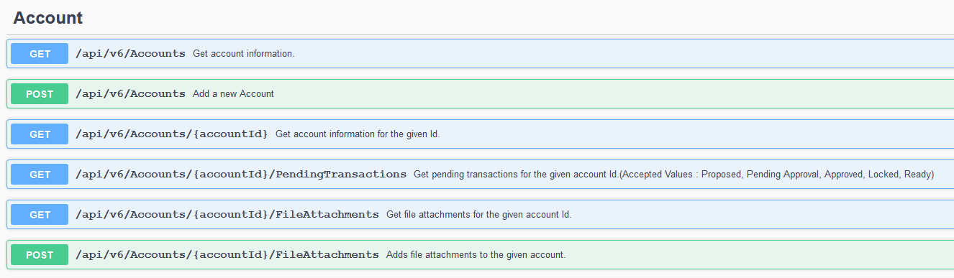
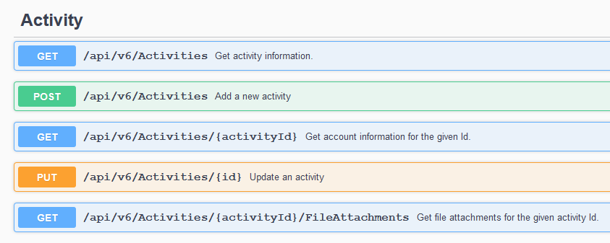

Slide 7

What will Change?
No Phonegap/Flutter
Different UI layout
Ran on a emulator
Added backend for UI
Test

Slide 8

Tech-Stack
Xamarin
C# Native Code
HTML/CSS/JavaScript
Azure

Slide 9

Member’s Background
Ja’von
Front-end
HTML, CSS
Back-end
Java, C++, MySQL, Python

Slide 10
Member’s Background
Drew
Front-end
HTML, CSS, Javascript
Back-end
Java, C, C++, SQL, Python

Slide 11
Member’s Background
Chris
Front-end
HTML, CSS, Javascript
Back-end
Java, Python, C, C++, MySQL

Slide 12
Member’s Background
Nick
Front-end
HTML, ASP
Back-end
Java, C++, C#, C, SQL, Python

